Slide 1

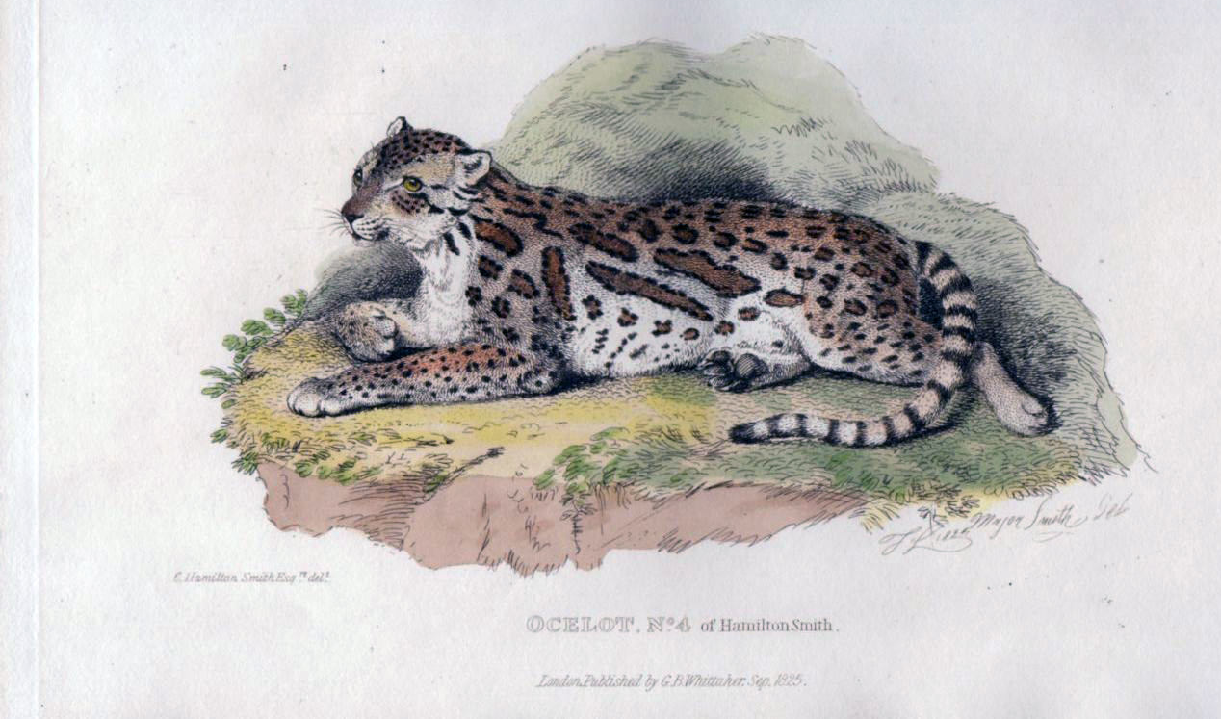
Using Vegetative Cover to Estimate Occupancy of Predators Near SH100
Proposed Project:
T. Miles Hopkins

Slide 2
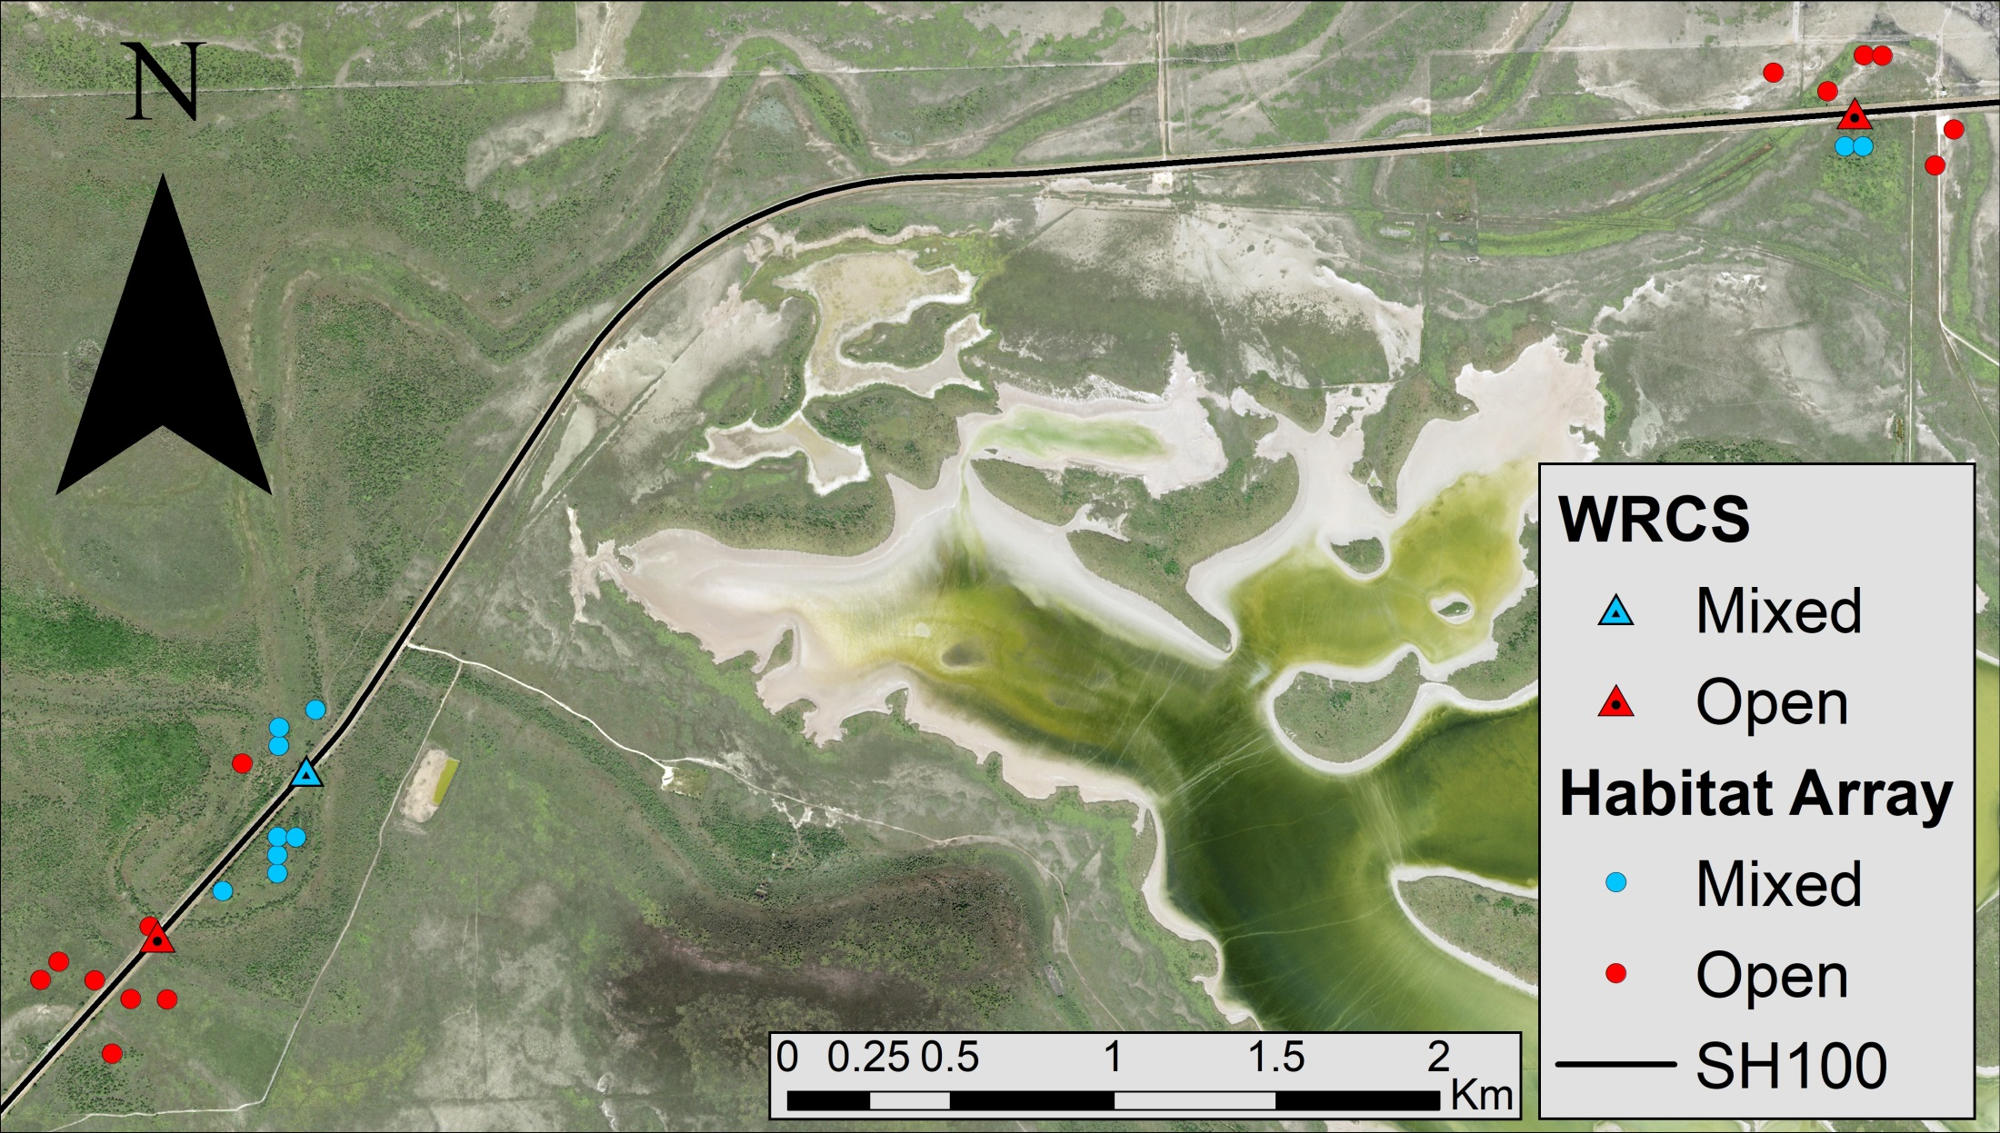
Vegetation Cover and Camera Array
Camera array to monitor wildlife crossing structures (WCS) on SH100
Using Habitat Array to determine expected crossing frequencies for WCS
May be able to use Habitat Array for occupancy modelling
WCS

Slide 3
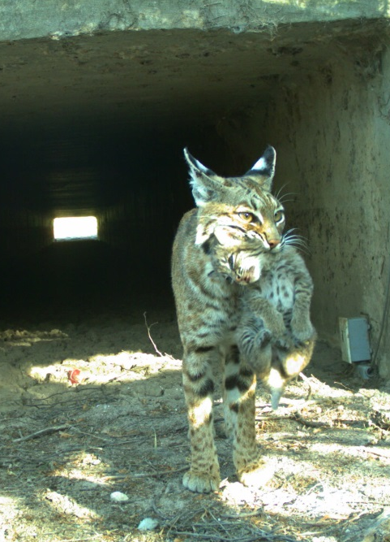
Predators Around SH100
WCS built to protect and promote ocelot movement around SH100
Few ocelots, difficult to monitor
Bobcats and coyotes used as approximates for ocelots
Easier to determine presence & absence

Slide 4
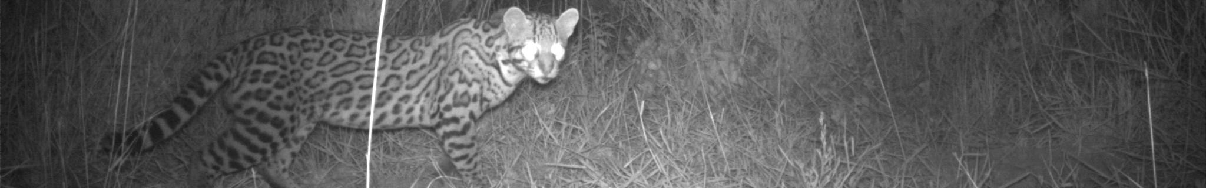
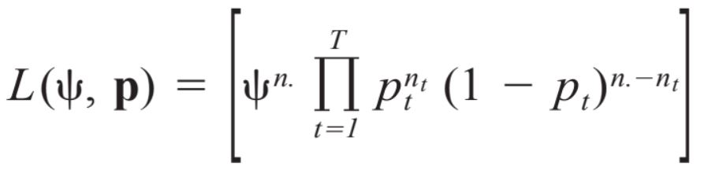
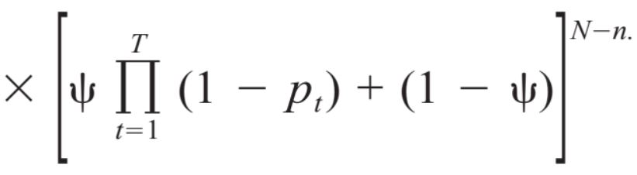
Occupancy Modelling
Occupancy: probability a patch is occupied by a species
Used to assess:
Species distribution
Habitat associations
Impacts of management actions
Based on presence-absence at sites
Spatial and temporal
Will use MacKenzie et al. (2002) approach
Detection probability <1
Assume:
Single-season monitoring
Occupancy probability is similar across all sites
Detection probability is constant over both time and space (sites)
Closed population

Slide 5
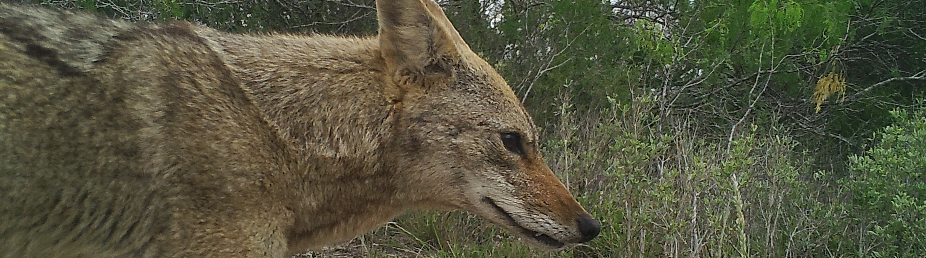
My Occupancy Model
Originally intended for thesis
Removed due to difficulty
Hard to model for low-density carnivores
Use vegetation cover as a covariate for estimating occupancy
Three occupancy models: bobcats alone, coyotes alone, and combined

Slide 6
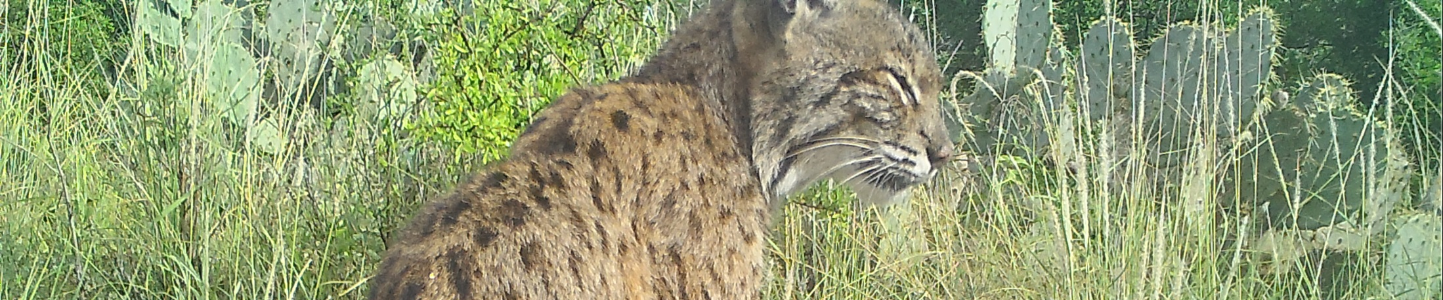
Combining Veg Map and Occupancy
Occupancy Model: Excel &/or R Studio
MacKenzie et al. (2002) explains how to do it in Excel
Will attempt in Python
Probability that a species is present at site (ψ): Primer &/or Python
Random bootstrap analysis based on vegetation cover
Vegetation map: ArcPy & Python
Overlay the occupancy model onto the veg map to create a map of occupancy: Python

Slide 7
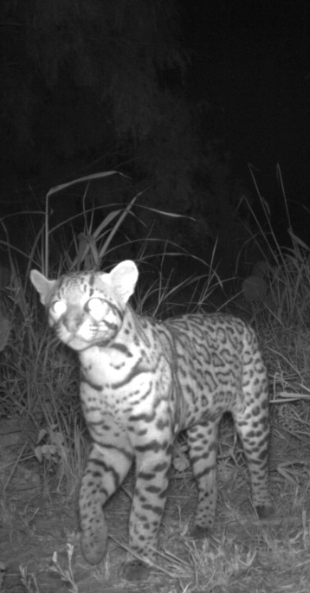
End Result: Occupancy Map
Create a color map surrounding SH100 and within the study area
Based on vegetation cover
Represent expected occupancy by each predator
May be used to determine future WCS locations
If vegetative cover can be measured can estimate expected occupancy by predators

Slide 8
End Result: Occupancy Map
Create a color map surrounding SH100 and within the study area
Based on vegetation cover
Represent expected occupancy by each predator
May be used to determine future WCS locations
If vegetative cover can be measured can estimate expected occupancy by predators

